Slide 1
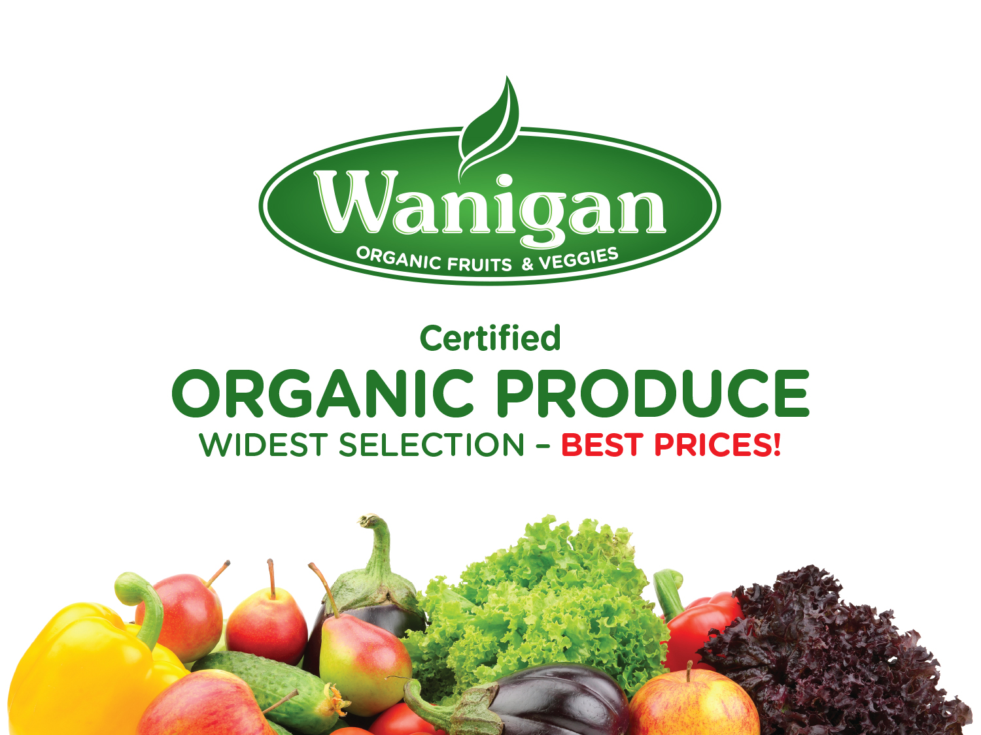

Slide 2

Wanigan
^{IN OUR STORE} ^{OR AT YOUR DOOR!}
^{Recipe Selection}
Over the years, we have complied a wonderful collection of recipes. Now you can find many of them available online at our website. You can search for recipes by ingredients and recipe title.
^{Produce Selection}
Discover useful storage tips, basic cooking instructions, food history and folklore, links to recipes, and nutritional facts. Designed around our weekly selection of organic and local fruits and vegetables.
^{• Organic}
^{• Raw Foods}
^{• Bulk Quantities}
^{• Dry Goods}

